Slide 1
PROBLEM IDENTIFICATION
Background: Big Mountain Resort has been collecting data over the years to optimize operations. However, the resort is facing challenges setting a competitive ticket price while also increasing or maintaining guest attendance, and covering the operating costs of the new $1,540,000 chairlift.
Strategy: Existing pricing strategies are not data-driven, for this reason we will focus on developing a data driven pricing strategy to develop an accurate predictive pricing model that can accurately forecast optimal ticket prices.

Slide 2
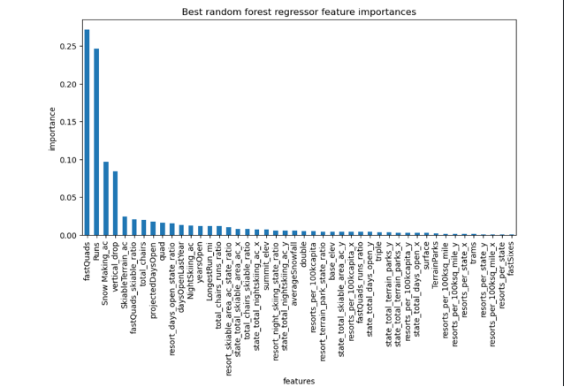
RECOMMENDATION AND KEY FINDINGS
Increase the ticket prices for Adults by $14.43 based on predictive modeling results on ticket pricing. This will optimize revenue and maintain competitiveness against other resorts.
Key findings show that a Random forest regressor is the most accurate predictive ticket price model.
Features such as Fast Quads, Runs, Snow Making (acres), and Vertical drops are categorized as highly influential on ticket price by the model.

Slide 3
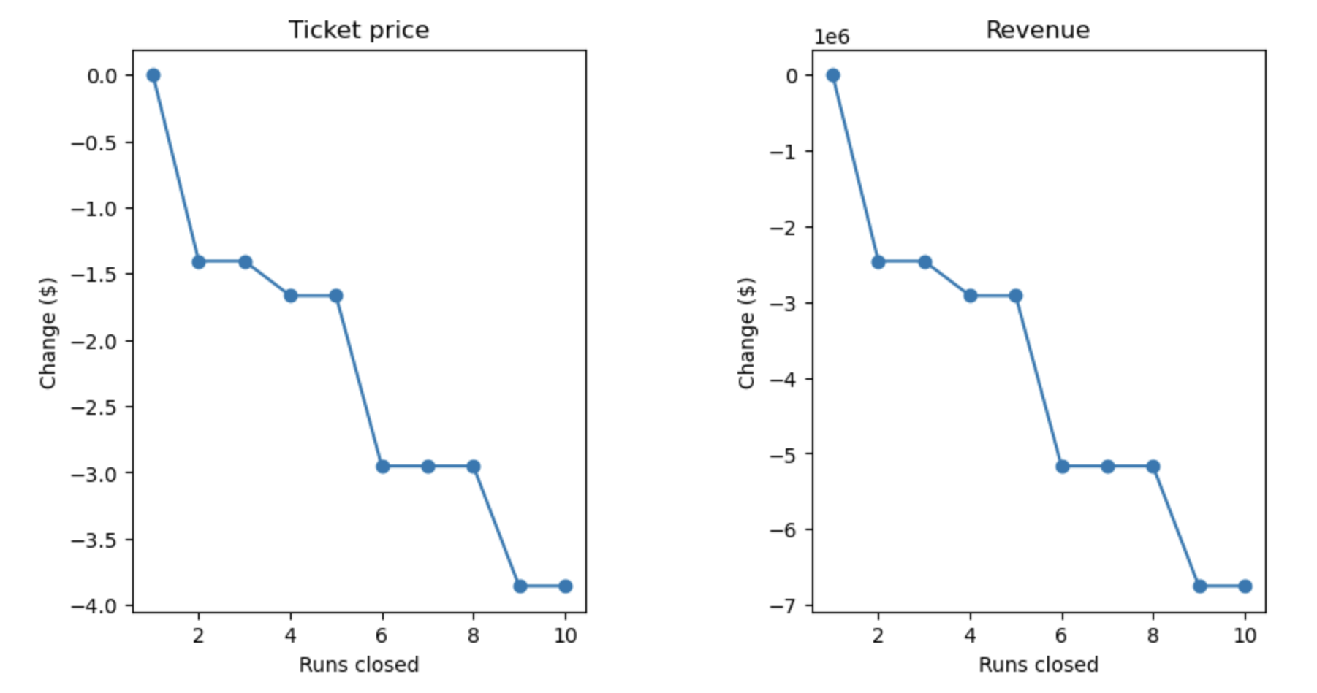
MODELING RESULT AND ANALYSIS
Scenario 1: Permanently closing down up to 10 of the least used runs.
The model indicates closing one run makes no difference. Closing 2 and 3 reduces support for ticket price and so revenue. Closing down 4 or 5 runs indicates little to no further loss in ticket price. Increasing the closures down to 6 or more runs leads to a large drop.

Slide 4
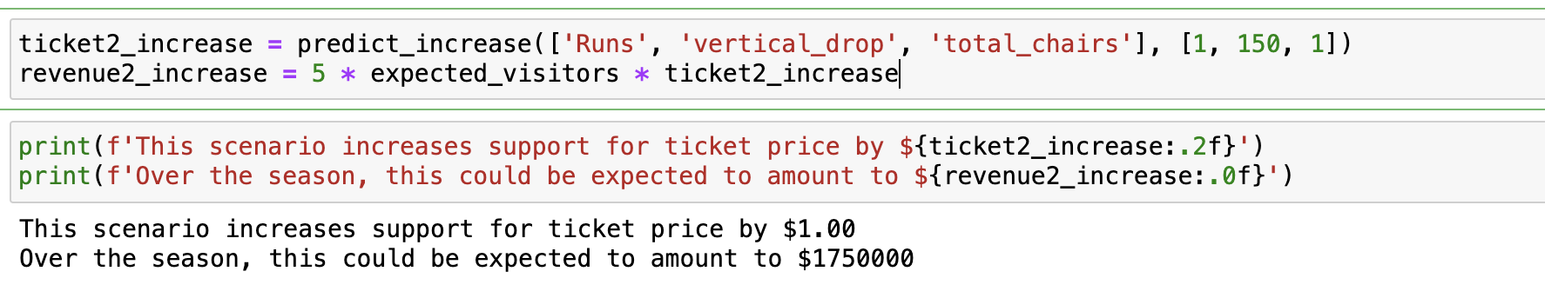
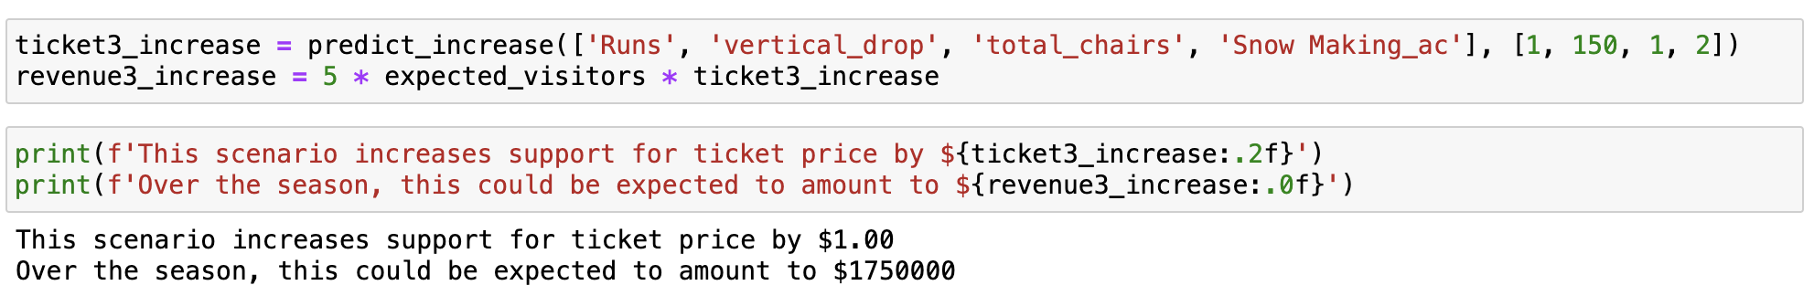
MODELING RESULT AND ANALYSIS
Scenario 2: Adding a run, increasing vertical drop by 150 feet, and installing an additional chairlift
Scenario 3: Adding a run, increasing vertical drop by 150 feet, installing an additional chairlift, and adding 2 acres of snow making.
A small increase in Snow Making doesn’t make a difference in ticket price.

Slide 5
MODELING RESULT AND ANALYSIS
Scenario 4: Increase the longest run by 0.2 mile to boast 3.5 miles length, requiring an additional snow making coverage of 4 acres
No difference in ticket price. This might be due to the Random Forest Regressor model, as it ranks LongestRun in the 14th place on feature importance.

Slide 6
SUMMARY AND CONCLUSION
Developed an accurate pricing model that suggests increasing the weekend ticket price of Adults by $14.43.
Implementing Scenario 2 will back an increase of $1 to the ticket price, signalling an increase of total revenue for the next ski season by $1750000.
Developed a rank of features based on their influence to ticket price, showing Fast Quads, Runs, Snow Making (acres), and Vertical drops as the most influential.
Future recommendations: To develop more predictive pricing models (e.g. on Adult Weekday prices) and improve accuracy, it is important to ensure data completeness, refine storage protocols, and actively look to gather additional data (demographics, seasonal trends)

